Slide 1
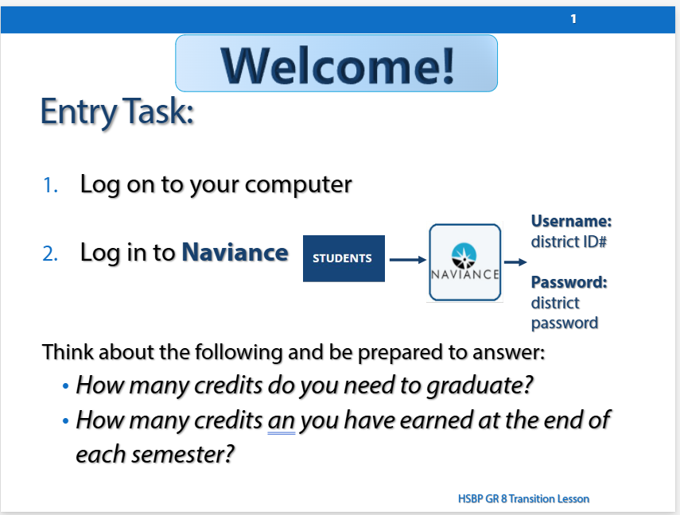
HSBP 8th Grade Transition Lesson
Updated lesson will be sent to 8th grade counselors
Both PDF & PPT (for editing)
Same system as last year with HAC
Please let me know what support you need! ☺

Slide 2
FAFSA / WASFA Updates
December Events:
  Everett HS – 80 attendees
  Cascade HS – 101 attendees
  Jackson HS – 87 attendees
Other Events:
  EHS Financial Aid Pizza Lunches
  Sequoia – Acct. Creation
    Dollars for Donuts
January Event:
  EPS & LETI – Hispanic Family Financial Aid Night
    1.30.25
    6-8pm
    LETI Everett Facility
February Event:
  Marshallese Financial Aid Help Event
    Tentative: 2.8.25 (Saturday)
    11am-1pm

